Slide 1

A Comparative Analysis of Custom Neural Architectures for Multi-class Livestock Classification
Evaluating CRNN, ViT, and GCNN on High-Variance Cattle Data
Name: Hamza Bin Abdul Majeed (Reg: SU92-MSAIW-S25-013)
Instructor: Sir Talha Nadeem

Slide 2
Introduction & Problem Statement
Context: Automated livestock identification is critical for disease management and farm productivity.
The Challenge: High variance in animal poses and significant class imbalance (Sheep vs. Pigs/Other).
Objective: To determine which deep learning paradigm (Hybrid, Transformer, or Graph) best handles complex veterinary imagery.

Slide 3
Exploratory Data Analysis (EDA)
Dataset Size: 22,342 instances across 6,570 images.
Class Distribution:
Sheep: 12,388 (Majority)
Cow/Horse: ~5,000 each
Pig/Other: Minority classes requiring robust feature extraction.
Processing: 1-channel Grayscale conversion and 224 \times 224 normalization for consistency.
Overall Dataset Instance Distribution
Class ID | Animal Class | Total Instances
0 | Cow | 4,146
1 | Pig | 545
2 | Sheep | 12,388
3 | Horse | 5,239
4 | Class_4 (Minority) | 24
Total |  | 22,342

Slide 4
Model Architecture 1 – Veterinary CRNN (SOTA)
3-layer CNN backbone for edge and texture detection.
Bidirectional LSTM (512 hidden units).
Treats the features as a sequence (28 by 28 patches), allowing the model to capture global context that standard CNNs miss.

Slide 5
Model Architecture 2 – Vision Transformer (ViT)
Patch embedding + Multi-head Self-Attention.
Relies on global dependencies rather than local convolutional filters.
Suffered from "data hunger" on minority classes, leading to an accuracy of 83.86%.

Slide 6
Model Architecture 3 – Graph CNN (GCNN)
Treats patches as nodes in a spatial graph.
To model non-Euclidean spatial relationships.
Fastest inference time but lowest accuracy (72.05%) due to difficulty in capturing fine-grained pathological textures.

Slide 7
Final Comparative Results
Final Comparative Results Table
Model Architecture | Final Test Acc (%) | Best Val Acc (%) | Best Val Loss | Key Structural Feature
CRNN | 94.49% | 95.90% | 16.00% | CNN Features + RNN Sequence
ViT | 83.86% | 85.69% | 46.90% | Self-Attention Mechanism
GCNN | 72.05% | 72.97% | 62.86% | Spatial Graph Connectivity

Slide 8
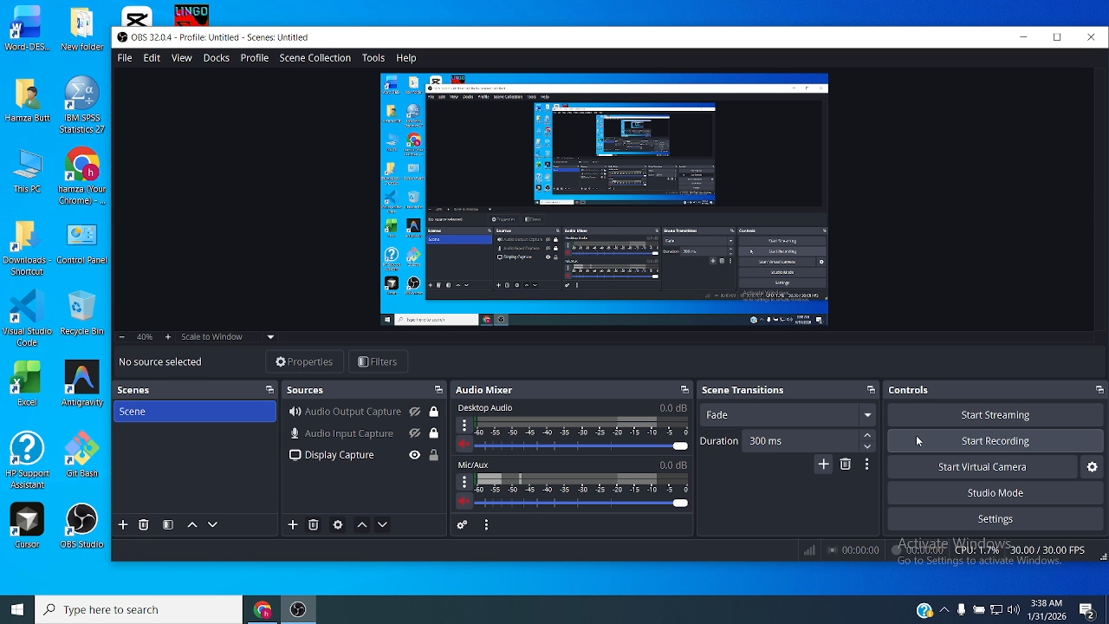
Demo

Slide 9
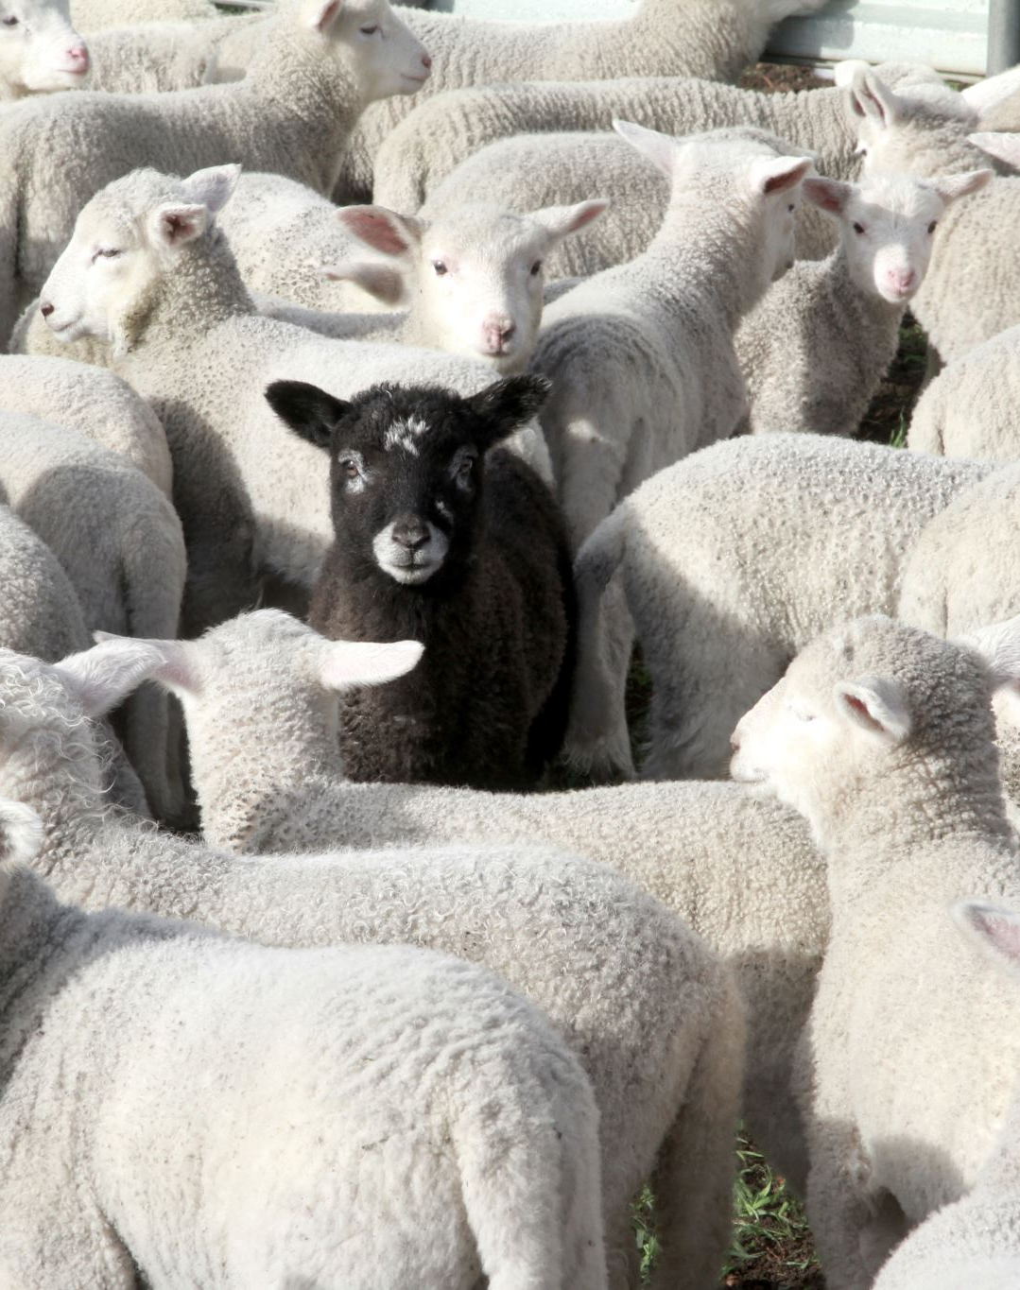
Conclusion & Future Scope
Final Verdict: The research identifies the Hybrid CRNN approach as the clear winner for livestock data, achieving 94.49% accuracy by successfully bridging the gap between spatial feature extraction and sequential pattern recognition.
Key Insight: While Transformers (ViT) are powerful, the inductive bias of CNN-RNN hybrids remains more effective for livestock classification in high-variance, imbalanced data environments.
Future Work: * Integrating the optimized CRNN model into IoT-enabled drone cameras for real-time field monitoring.
Expanding the dataset to include thermal imagery for early-stage fever detection in cattle.

Slide 10

Project Links
GitHub Repository: A Comparative Analysis of Custom Neural Architectures
Live App (Hugging Face): Cattle Disease Classifier Space
Core Implementation (Kaggle):
CRNN (Best Model)
ViT Implementation
GCNN Implementation
EDA & Dataset Analysis

